Slide 1
WHAT IS A STARTUP?
If it is incorporated as a private limited company (as defined in the Companies Act, 2013) or registered as a partnership firm .(registered under section 59 of the Partnership Act, 1932) or a limited liability partnership (under the Limited Liability Partnership Act, 2008) in India;
Up to seven years from the date of its incorporation/ registration; however, in the case of Startups in the biotechnology sector, the period shall be up to ten years from the date of its incorporation/ registration;
If its turnover for any of the financial years since incorporation/ registration has not exceeded Rupees 25 crores;
If it is working towards innovation, development or improvement of products or processes or services, or if it is a scalable business model with a high potential of employment generation or wealth creation.

Slide 2
Startup India Benefits
IPR Benfits
To promote awareness and adoption of IPRs by Startups and facilitate them in protecting and commercializing the IPRs, Startup India provides access to high quality Intellectual Property services and resources
Fast-tracking of Startup patent applications:
The patent application of Startups is fast-tracked for examination and disposal
Panel of facilitators to assist in filing of IP applications:
A panel of Facilitators is responsible for providing general advisory on different IPRs as also information on protecting and promoting IPRs in other countries.
Government to bear facilitation cost: Central Government bears the entire fees of the facilitators for any number of patents, trademarks or designs that a Startup may file, & Startups only bear the cost of the statutory fees payable.

Slide 3
Self-Certification under Labour and
Environment Laws
To reduce the regulatory burden on Startups thereby allowing them to focus on their core business and keep compliance cost low, Startups are allowed to self-certify their compliance under 6 Labour and 3 Environment laws for a period of 5 years from the date of incorporation.

Slide 4
Fund of Funds for Startups
To provide equity funding support for development and growth of innovation driven enterprises, the government has set aside a corpus fund of 10,000 crores managed by SIDBI.
.

Slide 5
Faster Exit for Startups
MCA(Ministry Of Corporate Affairs) has notified Startups as ‘fast track firms’ enabling them to wind up operations within 90 days vis-a-vis 180 days for other companies. An insolvency professional shall be appointed for the Startup, who shall be in charge of the company for liquidating its assets and paying its creditors within six months of filing an application in this regard.

Slide 6
Tax Exemption
IMB Certified
The Inter-Ministerial Board validates the innovative nature of the business for granting tax related benefits and is constituted by representatives from DIPP, DBT, DST and MEITY. Startups incorporated on or after 1st April 2016 can apply for tax benefits and such innovative applications are then moderated by the Inter Ministerial Board before granting the certificate of eligibility.

Slide 7
Tax Exemption for 3 years
The profits of recognised Startups that are granted an Inter-Ministerial Board Certificate are exempted from income-tax for a period of 3 years (out of a block of 7 years). This fiscal exemption is aimed at facilitating growth of business and meeting the working capital requirements during the initial years of operations

Slide 8

RESOURCES FOR STARTUPS
Learning and Development Program
.
Notes:
The program covers lessons on key areas of starting up by 40+ top founders of India in an extensive 4-week program.
certificate acknowledging their effort and certifying their learning's in the program.

Slide 9
RESOURCES FOR STARTUPS
Learning and Development Program
The website hosts a variety of courses which broadens the vision of budding entrepreneurs and guides them through the journey of their Startup venture. The program covers lessons on key areas of starting up by 40+ top founders of India in an extensive 4-week program. Not just that, upon completion of the course, the apprentice receives a certificate acknowledging their effort and certifying their learnings in the program.

Slide 10
Government Schemes
Many government departments are working to promote entrepreneurship in India. Startup India has collated various schemes from various ministerial bodies at one place to facilitate and save your time from jumping between websites!
State Government Policies
Startup India presents to you a list of 17 state government policies who offer benefits to Startups! Startups and entrepreneurs across these states can access the policy documents, website links and contact details of the respective nodal agencies.

Slide 11
Knowledge Bank
Registering a company is not a cake walk if you do not know the legalities. Startup India provides a knowledge bank detailing the requirements for starting a business in India; be it registering a company, filing IPRs, complying to tax policies or understanding the investor landscape in India! Startup India has got you covered and you do not need to spend time surfing the internet or gain information from disintegrated sources!

Slide 12
Networking And Discussion
All members of the startup ecosystem – Startups, investors, mentors, incubators, accelerators and government bodies can connect with each other on this platform. The platform provides the eco system stakeholders with the opportunity to discuss – express and opine on the forum through discussion threads – blogs and one to one messaging.

Slide 13
10000 Startups
10,000 Startups aims at building a cross-collaborative platform to enable startups to grow to the next level by leveraging our network of investors, mentors, industry experts, and enterprises.
FAME MODEL(Funding, Acceleration, Mentoring, and Enterprise connects)
The 10,000 Startups FAME model is designed to facilitate the ideal connection between startups and Funders, Accelerators, Mentors, and Enterprises with complementary requirements, so that they may mutually benefit from each other

Slide 14
10000 NASSCOM
Funding: The NASSCOM 10,000 Startups programme helps shortlisted startups raise money from a wide range of investors- angels, micro VCs, VCs, and Government funds.
Acceleration: Once shortlisted for the programme, startups can work with the top accelerators. The NASSCOM 10,000 Startups programme presents unprecedented opportunities and a fast track into the top accelerators for shortlisted startups.
Mentoring: Focused group workshops are held for the shortlisted companies on Product Management, Go-to-Market Strategy, Pitching and Industry Insights from the experts.
Enterprise connect: Shortlisted startups get opportunities to showcase their product to top executives across industries and explore strategic partnerships, alliances, M&As , etc., and

Slide 15
PROGRAMS AND EVENTS
Apart from the FAME framework, we also offer a number of programs and events that are designed to help deserving startups through various stages of their growth
Warehouse Program :-
The Warehouse Program is the perfect package to provide fledgling companies with everything they’ll need for the initial stages of their startup journey, from a physical workspace and furniture, to expert guidance and networking opportunities.
Eligibility Criteria
Only startups with a minimum viable technology product are eligible to apply for this program. It is strongly suggested that the product be beyond its ideation phase.
Virtual program :-
Our Virtual Program is designed to help growth-stage startups that have their own workspaces take their business to new heights. The program creates the optimal environment for such startups to scale up by providing support in the form of a startup kit, and connecting the company with our widespread network of evaluators and mentors, who are also investors, accelerators, and industry veterans.
Eligibility Criteria :-
Startups in the growth stage that have a reasonable amount of traction with a product already out in the market may apply for the Virtual Program.

Slide 16
NASSCOM Industry Partnership Program
NASSCOM is India’s largest industry-backed corporate innovation program.
The NASSCOM Industry Partnership Program (NIPP) seeks to foster sustained engagement between large corporations and innovative technology ventures in India.
BENEFITS:-
Direct fast access to senior executives
Access to executive mentoring, early technology, and deep expertise
Access to strategic investments and grants
Faster access to global markets and JV/OEM/partnership options
Participate in customer showcases, events, speaking opportunities, and delegations

Slide 17
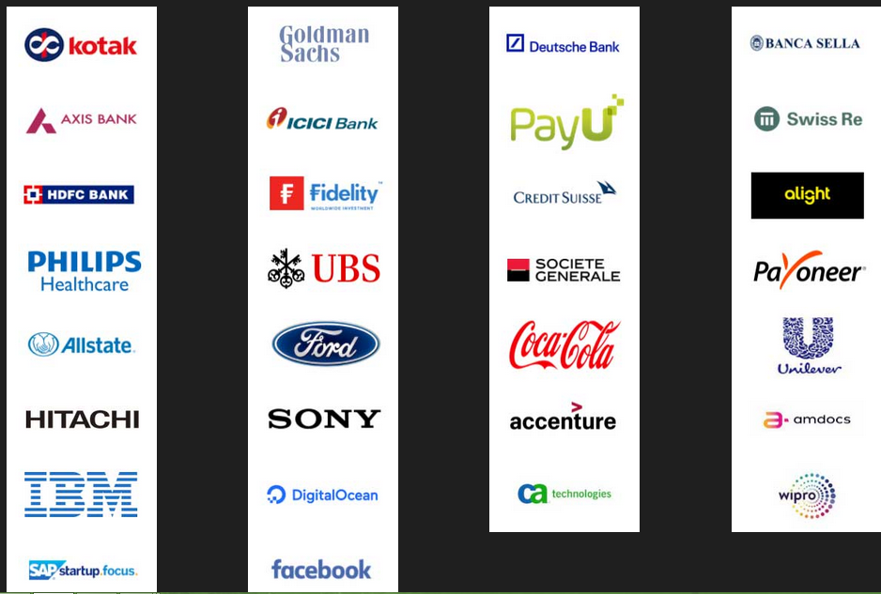
NIPP Partners

Slide 18
Rockstar program:-
The Rockstar Program is designed with the intent of making India a tech-innovation hub in the global arena. It will bring to the limelight innovations with disruptive potential, helping them gain worldwide recognition and trust.
RECOMMENDED CRITERIA :-
An IT product company incorporated in India whose product development is carried out in India or outside
An IP-backed company involved in technology product or technology platform, with the focus being on SaaS, IoT/robotics, blockchain, AI/ML/deep learning, and AR/VR
A company that has a commercialised product with paying customers
A company that stands out in emerging technologies with the domain focus being health, finance, retail, education, and enterprise

Slide 19
Nasscom Gaming Forum
NASSCOM ® is India’s premier trade body and chamber of commerce for the IT industry, and the NASSCOM Gaming Forum (NGF) was set up ten years ago to provide a common platform to share best practices and knowledge to developers and businesses within the Indian gaming industry, especially the burgeoning indie game dev community.
NASSCOM Game Developer Conference (NGDC)
The NASSCOM Game Developer Conference (NGDC) is India’s primary platform for creators and enthusiasts of computer, mobile, console, web, and social games to showcase, inspire, learn, and interact.

Slide 20
Nasscom Gaming Forum
NASSCOM Game Developer Conference (NGDC)
NGF Awards:-
Student game of the year
Indie game of the year
Studio Game of the Year
Upcoming Game of the year
BYOG
Incubation services
Game Jam Titans

Slide 21




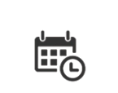
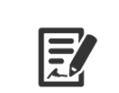
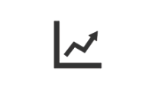
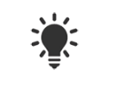
How to Define a startup?
Government of India Definition
7 years from date of incorporation
(10 yrs for biotech)
Pvt. Ltd. Company or
LLP or
Partnership Firm
Must not exceed
INR 25 Cr. in in any fiscal year
Developing new or improving existing product/service offering

Slide 22
Recognition Procedure
Government of India Recognition
ONLINE APPLICATION FORM
UPLOAD SUPPORTING DOCUMENTS
APPLICATION EVALUATION
RECOGNITION AS STARTUP
15 – 20 minutes
24 - 48 hrs
Submit details on Startupindia.gov.in
Founder & Team Details
Entity Details
Business model
IP details
Startup India Team evaluates proposal and takes action within 24 - 48 hrs of
If suitable, then application approved,
If answers are not suitable, then second chance given to startups to reapply

Slide 23
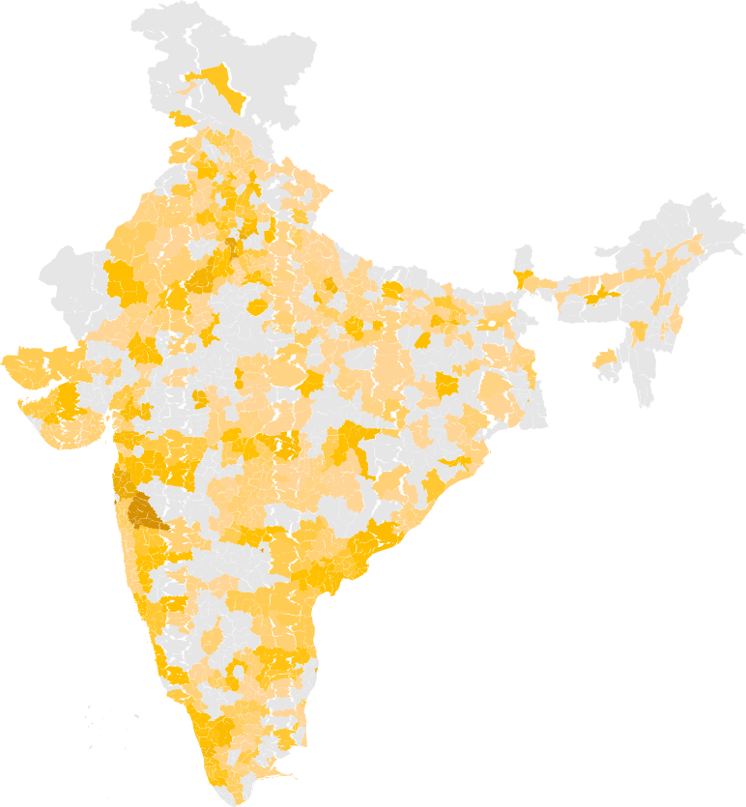

Startup India
Starting a startup revolution
STARTUP INDIA RECOGNITION
0
400
800
NO. OF STARTUPS RECOGNIZED
11,634
Startups Recognized with the Government of India
448
Districts
29
States
6
Union Territories
56%
Tier 1 Cities
27%
Tier 2 Cities
17%
Tier 3 Cities

Slide 24





Process simplification
Encouraging startups
Government Procurement
Patent
Granted
Tax
Benefit
Compliance
Regime
Faster
Exit
2018
Fast Track Examination
Income Tax Exemption
Self
Certification
Exempted
90 Days
2014
Experience, Turnover, EMD
required
Time Consuming Process
Nil
Physical Inspection
> 4 years

Slide 25

Startup India
Benefits for startups
Relaxation of Public Procurement Norms
Relaxation of turnover, experience, & EMD condition for startups
All Central Public Sector Undertakings to follow procedures and give preferential treatment to startups
DIPP Recognised startups can directly register and sell on Government-e-marketplace (GeM) with no requirement of turnover & experience criteria

Slide 26

Startup India
Benefits for startups
Patent & Trademark Benefits
80% rebate in patent filing fees
50% rebate in trademark filing fees
Empanelled 1,019 facilitators for free of cost filing & facilitation
Government to reimburse facilitators’ cost
801 applications have received 80% patent rebate
1,226 applications have received 50% trademark rebate

Slide 27

Startup India
Benefits for startups
Facilitation & Handholding
Dedicated facilitation support team at Invest India to handhold startups
48 hr response time for any startup enquiry made via email, twitter, or call centre
1,05,230 enquiries have been successfully resolved so far
547 startups mentored and facilitated by team (such as business advisory, financial advisory, tax & legal support, stakeholder introduction etc.)

Slide 28

Startup India
Benefits for startups
Easier Compliances
Inspections against 6 labour & 3 environmental laws relaxed for startups
Startups now allowed to self certify against laws; easing compliances for startups
Insolvency & Bankruptcy board constituted for fast track exit
90 day period for winding up operations as opposed to 4 yrs earlier

Slide 29

Funding Innovation
Building Capacities
INNOVATORS
Atal Tinkering Labs ₹ 488 cr.
Scheme run by NITI Aayog to set up tinkering labs in schools across India where young minds can give shape to their ideas through hands-on, do-it-yourself learning
2441 schools across India have been selected to setup tinkering labs
Grant-in-aid of INR 20 Lakhs per lab over a period of 5 years

Slide 30
Funding Innovation
Building Capacities
INNOVATORS
MANAK ₹ 30 cr.
Scheme run by Dept. of Science & Technology to strengthen science and technology system, increase R&D human resource base by inviting students from all government and private schools to send their original and creative technological ideas/innovations.
30,678 students received a grant of INR 10,000 each

Slide 31
Funding Innovation
Building Capacities
INNOVATORS
Uchhattar Avishkar Yojana ₹ 258 cr.
Scheme run by Min. of Human Resource Development to jointly fund research projects, along with private entities, undertaken by IIT students
Funding support provided to 85 research projects at various IITs, for product development & commercialization

Slide 32
Funding Innovation
Building Capacities
INFRASTRUCTURE
Incubation Centres ₹ 244 cr.
Supporting creating of world class incubation facilities across India that will enable entrepreneurs by mentoring and cultivating their ideas into successful ventures
NITI AAYOG
Dept. of Science & Technology
Dept. of Biotechnology

Slide 33
Funding Innovation
Building Capacities
INFRASTRUCTURE
Research Parks ₹ 665 cr.
Scheme run by Min. of Human Resource Development to setting up research facilities for incubation and joint Research and Development (R&D) efforts between academia and industry
Establishment of R&D facilities across 7 IITs & IISc Bangalore ( i.e. academia-industry collaboration)

Slide 34
Funding Innovation
Building Capacities
INFRASTRUCTURE
Bio Clusters & Regional Centres₹ 412 cr.
Spearheaded by Dept. of Biotechnology to promote innovation among Biotech companies and support commercialization of research
4 bio-clusters at Kalyani, Bangalore, Faridabad & Pune
3 BIRAC Regional Centres at Hyderabad, Bangalore & Pune

Slide 35
BANK LOANS FOR START-UPS IN INDIA
UNIT - 3

Slide 36
BANK LOANS FOR STARTUPS-
Broadly, there are three loan categories that you could borrow into. These loans are specific to what your business currently needs.
1. Working Capital Loan:
Working capital is the money you need to meet your day-to-day business expenses like your monthly electricity bills. All your operational costs come under working capital and some loans are crafted to suit your working capital needs alone. The loans are offered typically for a 12-month tenure and have an interest rate of 12% to 16%. These can be either secured or unsecured.

Slide 37
2. Corporate Term Loan:
Term loans are used to start a venture or expand a business. Therefore, if you are starting up, you may want to look at term loans/funding. These are large sums of money borrowed from banks or financial institutions that are expected to be repaid over a longer period of time. These loans are secured (company assets) and have a longer tenure and the interest rate is negotiable. They can be converted into equity options and also have tax benefits.
3. Term Loan:
These loans are used to buy fixed assets. If you want to put up an office, you could consider borrowing a term loan. Typically, these loans are secured with a tenure of 1-10 years and a floating interest rate between 10 and 20%.

Slide 38
1. The Credit Guarantee Fund Scheme (CGS) for Micro and Small Enterprises
This scheme is run by the government of India in collaboration with SIDBI (Small Industries Development Bank of India) to give unsecured loans to businesses.
You can borrow up to Rs.100 Lakh in term loans or working capital loans as per your eligibility and feasibility.
The corpus of CGTMSE is being contributed by the GoI and SIDBI in the ratio of 4:1 respectively and has contributed Rs. 2477.78 crore to the corpus of the Trust up to May 31, 2016.

Slide 39
2. The MUDRA Loan Scheme
MUDRA stands for Micro Units Development and Refinance Agency Ltd.
It is an agency launched by the government of India to facilitate corporate term loans to entrepreneurs.

Slide 40
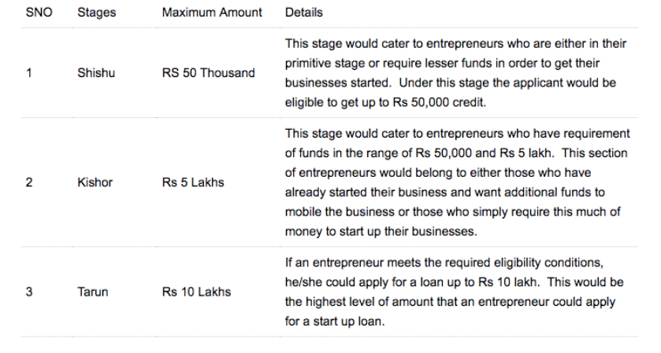

Slide 41
3. Stand Up India Scheme
The Stand Up India scheme is a special scheme started by the government of India to financially empower SC/ST and women entrepreneurs.
You can borrow between Rs. 10 lakh and Rs. 1 CR to start a manufacturing, trading or service unit, which is to be repaid in 7 years.

Slide 42
4. SIDBI Revolving Fund for Technology Innovation
It provides financial assistance to MSMEs towards development, up scaling, demonstration and commercialization of innovative technology based projects.
The assistance is given in the form of early stage “debt” funding on softer terms for development, demonstration and commercialization of new innovations in emerging technological areas, un-proven technologies, new products, process, etc. which have not been successfully commercialized so far.
Maximum assistance is generally not more than Rs. 1 crore per project. Interest rate would be as approved by the Project Approval Committee (PAC) (not be more than 5% p.a.).

Slide 43
5. Growth Capital and Equity Assistance
Who is it for-
Existing Small and Medium Businesses in need of Capital for Growth.
It provides assistance in form of Mezzanine/ Convertible Instruments, Subordinated debt and Equity (in deserving cases).

Slide 44
LAWS FOR STARTUPS
Basics of accounting and tax related laws
Understanding your local and country GST tax code is critical, as it could mean a lot of trouble if not followed to the T. Your government needs you to file monthly, and save all invoices and transactions while entering them via the online GST web portal. You need to register for the GSTN number and align your Aadhar, PAN and other details to the portal to maintain compliance

Slide 45
LAWS FOR STARTUPS
Choosing the type of venture
Choosing the type of company needed is also important. For example, small/startup companies should register as a LLP, Pvt. Ltd., or Corporationaccording to what their needs are and what the suppliers and vendors need to fulfil orders. You can also register as an OPC (One Person Company) which needs only one director to start off, while all rules of the Pvt. Ltd. variety are applicable. There are various steps to ensure that all that is needful is done, and you need to follow these regulations appropriately. Ensure that your legal status is as per the business you’re a participant in.

Slide 46
LAWS FOR STARTUPS
Service Agreement and Documentation
There is a strong need for agreements and bonds that help in any future legal proceedings if things go awry. You need an SLA with every vendor, customer, client, etc. and must ensure that all the laws of India are followed when crafting these agreements. Every agreement and document must state all rules of engagement and guidelines for the duration of the service agreed upon.

Slide 47
LAWS FOR STARTUPS
IT and Cyber Laws
Your startup must be compliant with all cyber and IT laws including digital signatures, storing customer data, cloud management, and data privacy. IT and cyber laws are applicable to all businesses that operate in India and startups in the tech space should be especially cognizant of these regulations

Slide 48
LAWS FOR STARTUPS
Intellectual Property Rules (IP)
There is a misconception in India that the courts don’t protect IP for companies in the country. In fact, just last year, Delhi Courts have made landmark rulings in protection of Intellectual Property, and there have been many startups emerging to support this growing industry of IP Law.

Slide 49
LAWS FOR STARTUPS
Industry-specific laws
There are industry-specific regulations within each industry that you are a player in. Pharma laws will differ slightly from e-commerce payments laws, but following them is the key to maintaining your legal status. For example, a law that could apply to your company is that of accepting cash for gamification. Accepting direct cash as a means of buying a lottery may be treated and taxed appropriately via a gambling law as applicable in the country. This, and many other laws, can be applicable on your startup, and it’s your job to conduct thorough research.

Slide 50
LAWS FOR STARTUPS
Residency
Indian laws mandate that at least one director on the board be a resident of India, i.e., have lived for a minimum of 182 days in India in the previous financial year. This is to ensure that a point of contact and a legal rights holder to the business is available in the country of operation.

Slide 51
LAWS FOR STARTUPS
Labour Laws
Each startup will eventually have to hire new people. Even if you plan to outsource or employ independent consultants, every such employee-employer relationship will be directed by labour legislations.
Breaching these will not only harm you financially but also spreads a negative review about the startup even before you initiate it.
Productivity of employees and ultimate success of the startup are dependent upon how happy your employees are to work for you.

Slide 52
LAWS FOR STARTUPS
Contract laws and dispute resolution
A business survives on contracts. Nevertheless, disputes may be one of the unavoidable consequences of few contracts sometimes. Therefore, fundamental knowledge regarding contracts, arbitration, mediation, conciliation can smoothen the progress of a successful business.

Slide 53
WHAT IS SEZ
A special economic zone (SEZ) is a geographical region that is designed to export goods and provide employment.
SEZs are exempt from federal laws regarding taxes, quotas, FDI-bans, labour laws and other restrictive laws in order to make the goods manufactured in the SEZ at a globally competitive price.

Slide 54
DEFINITION OF SEZ
A special economic zone, in short SEZ is a geographically bound zone where the economic laws in matters related to export and import are more broadminded and liberal when compared to rest of the country.
SEZs are protected as duty-free areas for the purpose of trade, operations, duty, and tariffs. SEZ units are self-contained and integrated having their own infrastructure and support services.

Slide 55
SEZ AND EXPORT PROMOTION
The SEZ and export promotion facilitated the growth of the Indian SEZs, as per the web site of maps of india.com, where the provisions of Indian export policy is detailed. The main factor for the underperformance of these SEZs were poor export policy of India, which was loaded with huge taxes and duties. the government of India eased the export policy of India to facilitate easy growth of SEZ and export promotion of Indian goods across international destinations.

Slide 56
The provisions of Indian export policy, which facilitated the growth of SEZ and export promotion of Indian goods, are as follows :
Exemption of duties on Indian capital goods, and inputs are offered as per the requirements of the approved business activity.
Taxes are either exempted or waived and even reimbursed in case they are paid in advance to the concerned authority.
Duty-free imports of spares, raw materials, capital goods, and consumable are offered as per there requirement of the approved business activity.

Slide 57

SEZS SET UP BY THE CENTRAL GOVERNMENT
SEEPZ special economic zone Mumbai, Maharashtra electronics and Gems and jewellery
Noida special economic zone Uttar Pradesh multi product
MEPZ special economic zone Chennai, Tamil Nadu multi product
Cochin special economic zone cochin, Kerala multi product
Falta special economic zone falta,West Bengal multi product

Slide 58
THE NEED FOR SEZ AND GOVERNMENT’S POLICY
SEZ policy introduced on 1/4/2000 in India
To increase exports
SEZ can be set up by private, public, joint sector or by the state government
Convert EPZ to SEZ

Slide 59
PROVISIONS UNDER SEZ
100% FDI for manufacturing sector
No caps on foreign investments for SSI reserved items
Income tax benefit
Duty free import of domestic goods
Exemption from CST
Exemption from Income tax on investments
Enhanced limit of 2.4 crore for managerial remuneration
Applicability of labor laws

Slide 60

EVALUATION OF SEZ
Determine how resources are used
Whether Employment opportunities are created
Cost outweighs the benefit of SEZ

Slide 61
SEZ CONTROVERSY
In spite of the strong objectives of the Indian government, the SEZ policy has the following controversies :
Generation of a little new activity as there may be relocation of industries to take advantage of tax concessions.
Revenue loss.
Large-scale land acquisition by the developers may lead to displacement of farmers with a meager compensation.
Acquisition of prime agricultural land, having serious implications for food security.

Slide 62
ADVANTAGES OF SEZ
Growth and development
Attracts FDI
Exposure to technology and global markets
Increase in GDP and economic model
Employment opportunities are created

Slide 63
DISADVANTAGES OF SEZ
Exploitation of laborers
Women exposed to sexual harassment
Loss of revenue for Government
Fertile lands being used for establishing industrial units

Slide 64
CONCLUSION
SEZ can become a dangerous tool
A well defined strategy required for SEZs to be successful
SEZs appeal to most developed countries

Slide 65
Export promotion schemes
Software Technology Parks (STPs)
Special Economic Zones (SEZ) Scheme

Slide 66
BENEFITS UNDER STP SCHEMES:-
Customs Duty Exemption in full on imports.
Central Excise Duty Exemption in full on indigenous procurement.
All relevant equipment / goods including second hand equipment can be imported (except prohibited items).
Equipment can also be imported on loan basis/lease.
100% FDI is permitted through automatic route.
Sales in the DTA up to 50% of the FOB value of exports permissible.
Use of computer imported for training permissible subject to certain conditions.
Depreciation on computers at accelerated rates up to 100% over 5 years is permissible.

Slide 67
BENEFITS UNDER SEZ SCHEMES:-
Duty free import/domestic procurement of goods for development, operation and maintenance of SEZ units
100% Income Tax exemption on export income for SEZ units under Section 10AA of the Income Tax Act for first 5 years, 50% for next 5 years thereafter and 50% of the ploughed back export profit for next 5 years.
Exemption from Central Sales Tax, Exemption from Service Tax and Exemption from State sales tax. These have now subsumed into GST and supplies to SEZs are zero rated under IGST Act, 2017.
Other levies as imposed by the respective State Governments
Single window clearance for Central and State level approvals.
This scheme has a significant impact on future exports & employment. About 230 IT-ITeS specific SEZs have been notified by the DOC.

